Slide 1

SCIENCE_QTECH EMPLOYEE PERFORMANCE MAPPING- WRITE UP SQL assessment

Slide 2
1. Create a Database named employee
Create a database using CREATE DATABASE statement.
Import the following tables using import wizard:
data_science_team.csv
proj_table.csv
emp_record_table.csv

Slide 3
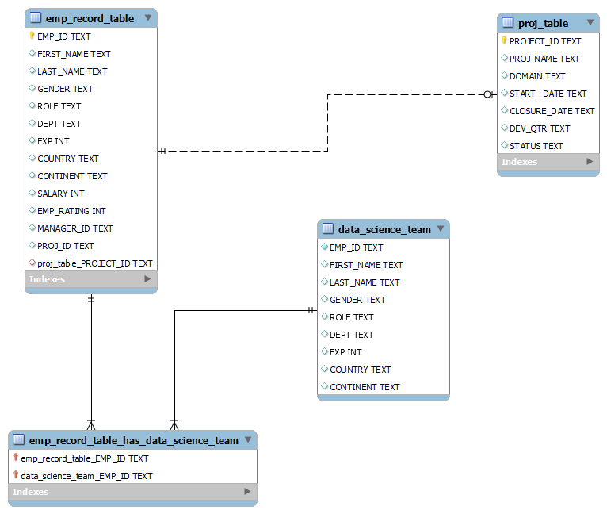
2. Create an ER diagram for the given employee database.

Slide 4
3. List of employees and details of their department
Retrieve employee id, first name, last name, gender and department from emp_record_table.

Slide 5
4. EMP_ID, FIRST_NAME, LAST_NAME, GENDER, DEPARTMENT, and EMP_RATING if the EMP_RATING is: i) less than two. ii) greater than four. iii) between two and four.
Retrieve employee id, first name, last name, gender, department and employee rating from emp_record_table using FROM and WHERE clauses.

Slide 6
5. Concatenate First Name and Last Name of Employees in Finance Department into column called Name
Retrieve full name of employees from Finance department using concatenate(CONCAT) function.

Slide 7
6. List of employees who have someone reporting to them, Also show the number of reporters (including the President).
Select the employees whose employee id is present in manager_id column using aliases.
Count the distinct entries to find the number of reporters.

Slide 8
7. List down all the employees from the healthcare and finance departments
Retrieve individual records of employees from healthcare and finance departments from emp_record_table and combine the results using UNION .

Slide 9
8. List down employee details grouped by department. Also include the respective employee rating along with the max emp rating for the department.
Retrieve employee records along with the maximum rating in each department. The maximum rating of employees from each department can be obtained by partition clause.

Slide 10
9. Calculate the minimum and the maximum salary of the employees in each role
Calculate maximum and minimum salary for each role using partition clause.

Slide 11
10. Assign ranks to each employee based on their experience. Take data from the employee record table.
Assign ranks to employees from each department using Rank() function. The partition clause is used to apply ranks through each department.

Slide 12
11. Create a view that displays employees in various countries whose salary is more than six thousand
Create emp_view using CREATE statement and filter records having salary more than 6000 using WHERE clause.
SELECT all records to display the view.

Slide 13
12. Nested query to find employees with experience of more than ten years
Nested Query:
The subquery returns employee ids from record who have experience greater than 10 years.
The outer query selects the records which have matching employee ids with those returned by the subquery.

Slide 14
13. Create a stored procedure to retrieve the details of the employees whose experience is more than three years.
Change the delimiter to &&, so that the procedure gets executed as a block. Create a procedure named get_exp- to retrieve data of employees having more than 3 years of experience.
Call get_exp() is used to run the procedure and display records.

Slide 15
14. Using stored functions in the project table to check whether the job profile assigned to each employee in the data science team matches the organization’s set standard.
Create function that takes experience and roles as input and returns the result as matched or not matched based on the conditions specified.
IF-THEN-ELSEIF-THEN statement is used to specify the conditions as per organization standards.

Slide 16
15. Create an index to improve the cost and performance of the query to find the employee whose FIRST_NAME is ‘Eric’ in the employee table after checking the execution plan.
Create index indx to assign index to first_name column.
The Explain statement shows that only one row was used to select the search criteria.

Slide 17
16. Query to calculate the bonus for all the employees, based on their ratings and salaries
Retrieve and display each employee from the record along with their bonus.

Slide 18
17. Calculate the average salary distribution based on the continent and country
Retrieve details of average salary of each country and continent using AVG function and Partition by clause.

